Slide 1
생물정보학 TERM Project
2024-06-13
서익현

Slide 2
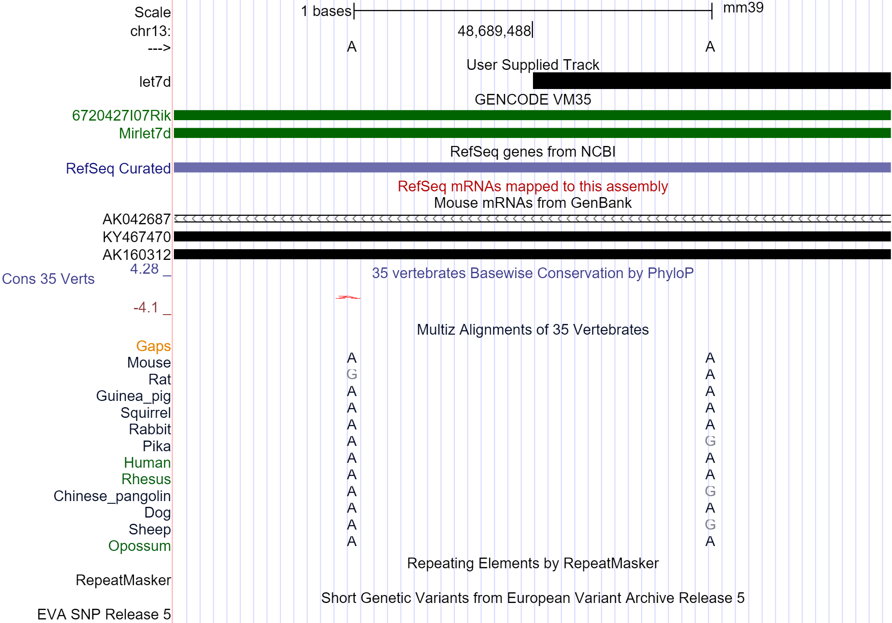
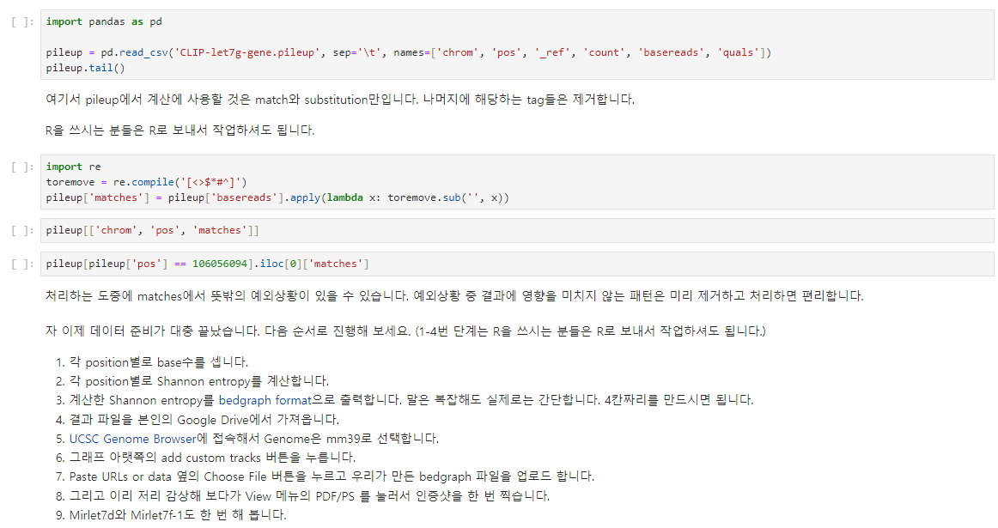
Guided Mission 과제
Shannon’s Entropy &
bedgraph??
Guided Mission-3

Slide 3
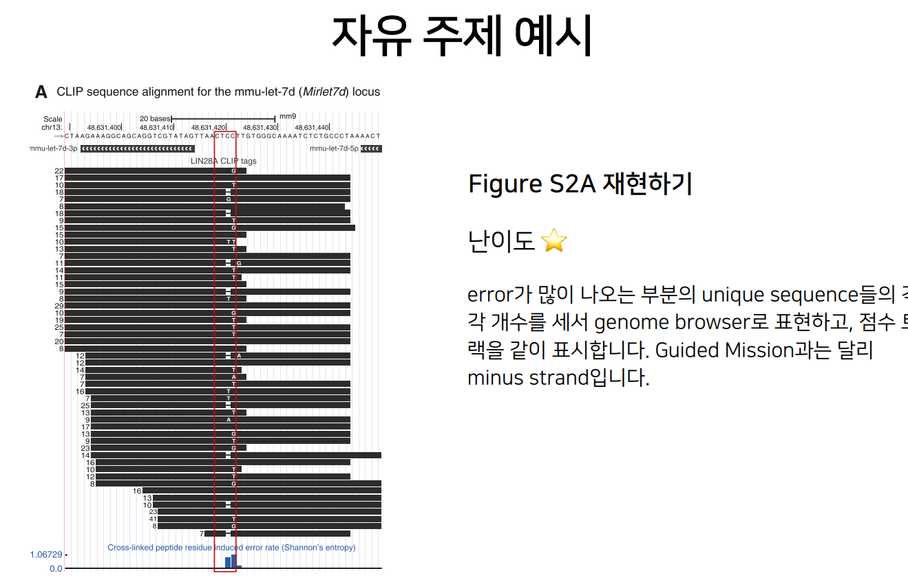
Guided Mission 과제
Shannon’s Entropy &
bedgraph??

Slide 4
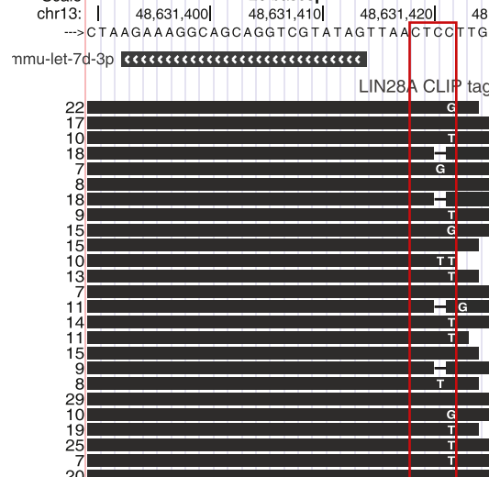
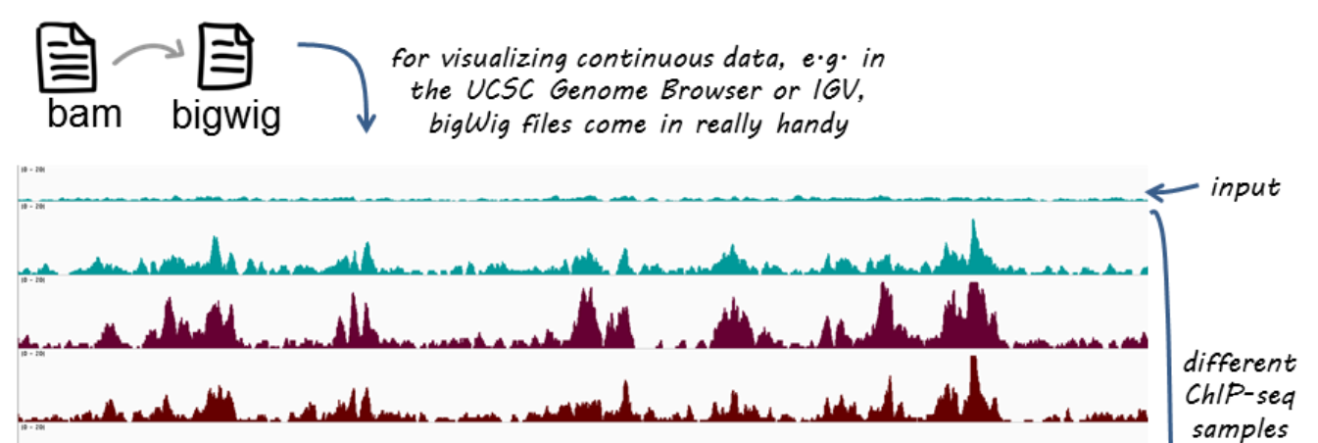
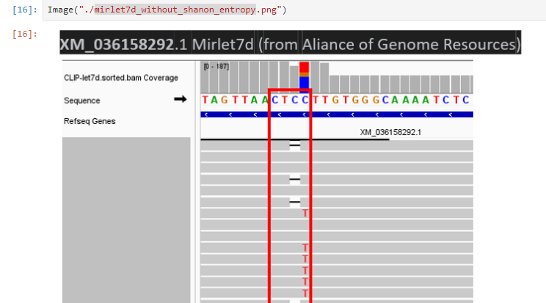
TermProject
How mutant and reads can be shown in genome browser?
Which files should I use?
Bam file
Compressed binary file of aligned sequence data.
Bigwig file
continuous data like coverage
or signal intensity.
Bed file
Text file format for storing genomic regions.

Slide 5
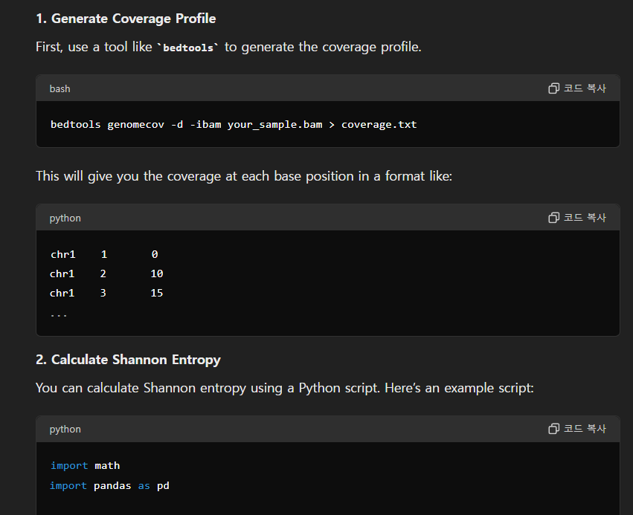
Guided Mission 과제
Shannon's Entropy:
a measure of the uncertainty or randomness in a dataset
DNA or RNA, it reflects the diversity of the sequence composition at each position.

Slide 6
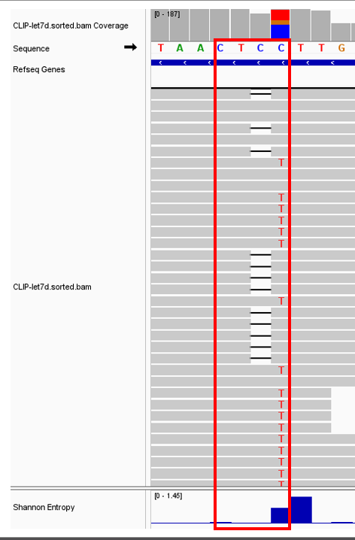
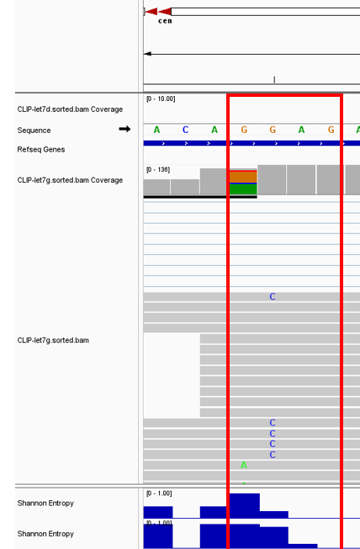
Guided Mission 과제
Mirlet-7g
Mirlet-7d

Slide 7
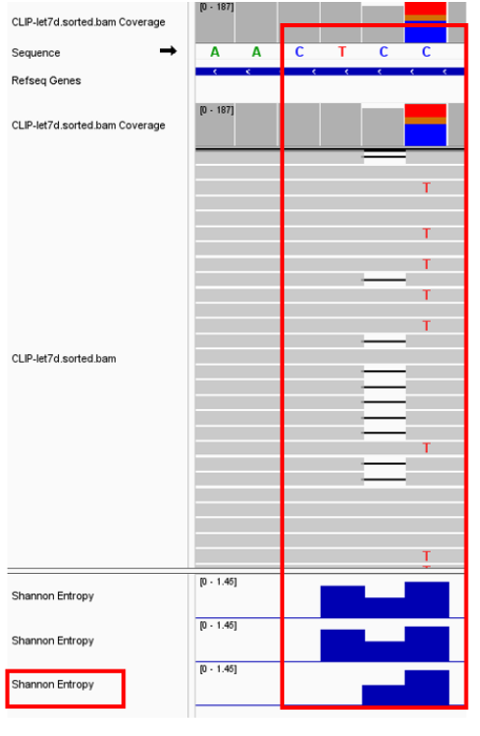
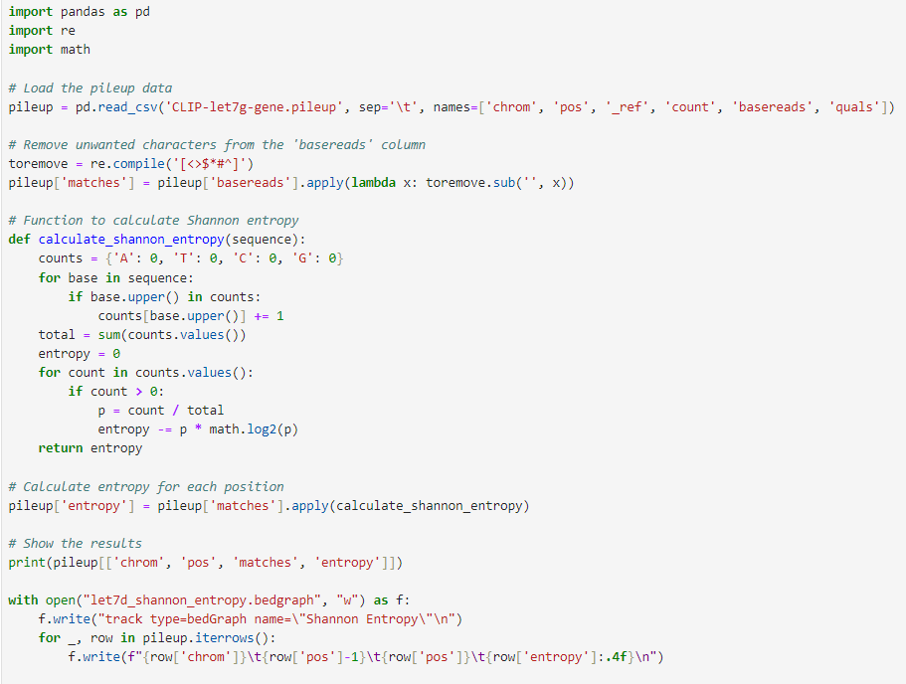
Guided Mission 과제
자세히 확인해보니,
mismatch에는 계산을 못하고 있었음!

Slide 8
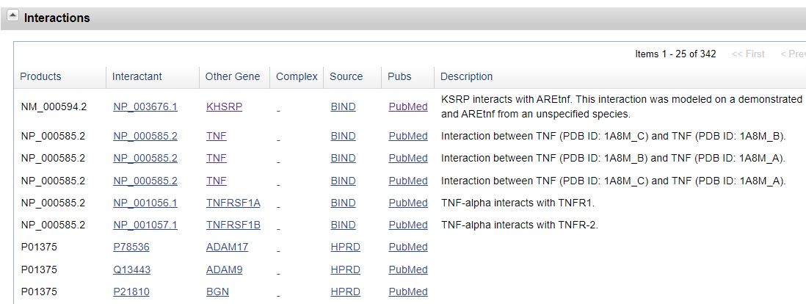
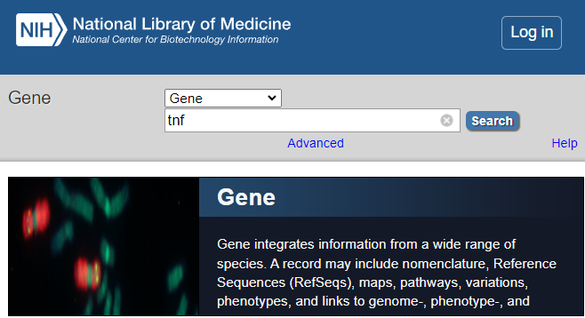

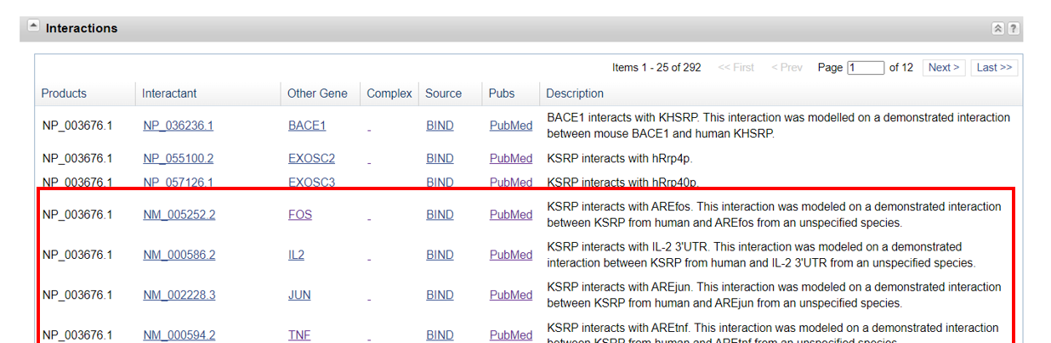
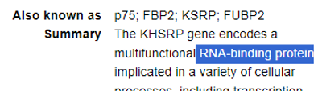
Future Study

Slide 9
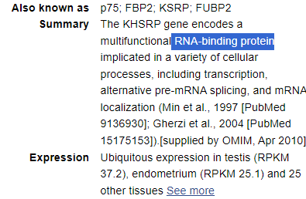
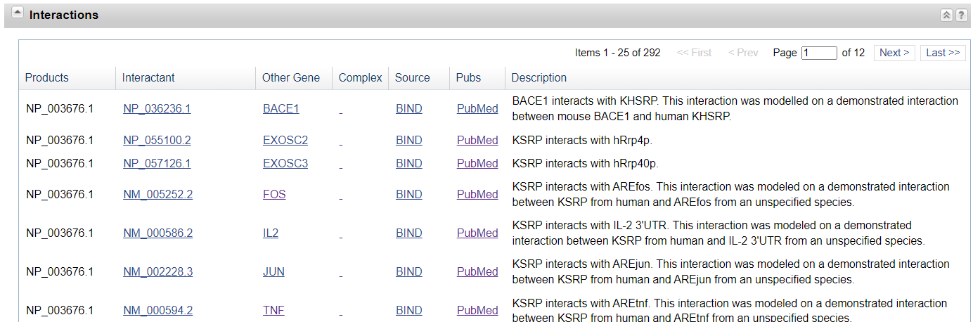
Design

Slide 10
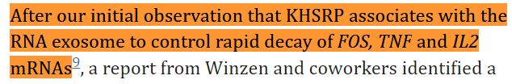
Design
Briata P, Wiley Interdiscip Rev RNA. 2016

